Slide 1
ANALYSIS AND PREDICTION OF COVID-19 Batch no:313
180030291-K.L.Lasya
180031282-D.Lahari
180030307-A.Lavanya
180030471-R.Akarsha

Slide 2
Abstact
The ML models have for quite some time been utilized in numerous application areas which required the distinguishing proof and prioritization of antagonistic elements for a danger. A few expectation techniques are by and large famously used to deal with anticipating issues. This examination shows the ability of ML models to estimate the quantity of impending patients influenced by COVID-19 which is as of now considered as a likely danger to humanity..

Slide 3
INTRODUCTION
AI (ML) has substantiated itself as a noticeable field of study throughout the most recent decade by settling numerous exceptionally mind boggling also, complex true issues. The application territories included practically every one of this present reality areas like medical services, independent vehicle (AV), business applications, regular language preparing (NLP), insightful robots, gaming, environment demonstrating, voice, and picture handling. ML calculations' learning is ordinarily founded on experimentation strategy very inverse of customary calculation.

Slide 4
PROBLEM DEFINITION
The organizer contains every day time arrangement rundown tables, including the quantity of affirmed cases, passings, and recuperations. All information are from the day by day case report and the update recurrence of information is one day.

Slide 5
LITERATURE SURVEY
The China Health Authority alarmed the World Health Organization (WHO) to a few instances of pneumonia of obscure etiology in Wuhan City in Hubei Province in focal China. The cases had been accounted for since December 8, 2019, and numerous patients worked at or lived around the neighborhood Huanan Seafood Wholesale Market albeit other early cases had no openness to this market. On January 7, a novel Covid, initially condensed as 2019-nCoV by WHO, was recognized from the throat swab test of a patient. This microbe was subsequently renamed as extreme intense respiratory condition Covid 2 by the Coronavirus Study Group and the sickness was named Covid illness 2019 (COVID-19) by the WHO. As of January 30, 7736 affirmed and 12,167 presumed cases had been accounted for in China and 82 affirmed cases had been distinguished in 18 different nations. Around the same time, WHO announced the flare-up as a Public Health Emergency of International Concern (PHEIC).

Slide 6
As per the National Health Commission of China, the death rate among affirmed cased in China was 2.1% and the death rate was 0.2% among cases outside China. Among patients conceded to emergency clinics, the death rate went somewhere in the range of 11% and 15%. Coronavirus is reasonably irresistible with a moderately high death rate, however the data accessible out in the open reports and distributed writing is quickly expanding. The point of this audit is to sum up the momentum comprehension of COVID-19 including causative specialist, pathogenesis of the illness, conclusion and treatment of the cases, just as control and avoidance procedures.

Slide 7
REQUIREMENTS
Hardware/Software | Hardware / Software element | Specification /version
Hardware | Processor RAM Hard Disk | I3 2GB 250GB
Software | OS | Windows, Jupyter Notebook-Python3
Web | Anaconda Navigator | Python Code

Slide 8
PURPOSE-TODAY’S WORLD
Around the world, the medical services laborers assume a fundamental part in the clinical administration of Covid-19 patients, however in Africa they are likewise in danger of disease given the degree of control measures in clinic wards. This investigation intends to get an early comprehension of key epidemiological attributes in the danger of transmission in medical care laborers in various African nations of the IPIN to illuminate leaders about the expected effect of SARS-CoV-2 contamination in this populace fundamental for the coherence of care. The examination will be done in emergency clinic wards responsible for the main Covid-19 cases.

Slide 9
The general target of this investigation is to comprehend the principle clinical, organic, virologic and immunological attributes of Covid-19 cases identified in Senegal to illuminate the turn of events and refreshing regarding wellbeing rules for cases the executives and lessen the expected effect of disease. A review and planned companion investigation of Covid-19 affirmed cases will be performed

Slide 10
EXISTING SYSTEM: Past works neglected to deal with long haul conduct changes PROPOSED METHODOLOGY: This paper seeks to fill the gap left by existing healthcare systems by using the to determine an outcome that is most likely for an individual patient, based upon their health conditions.

Slide 11
MODULES DESCRIPTIONS
In this module , we have executed the three machine learning models on covid – 19 .
Time Series Analysis
Prediction Analysis
SIR Model

Slide 12
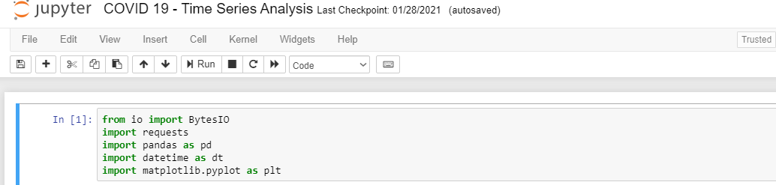
MODULE IMPLEMENTATION& EXPERIMENTAL RESULTS
Before we jump into information science and Analytics, how about we start
with bringing in the fundamental modules:

Slide 13
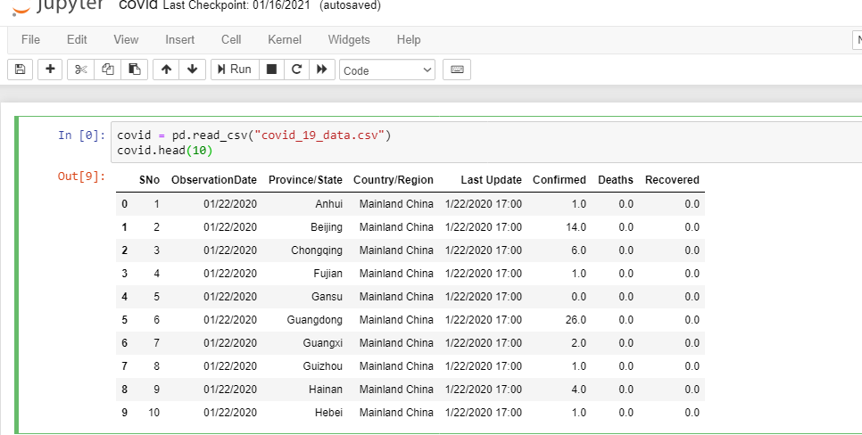
Among all the authority and informal information sources on the web giving
Coronavirus related information, perhaps the most generally utilized.

Slide 14
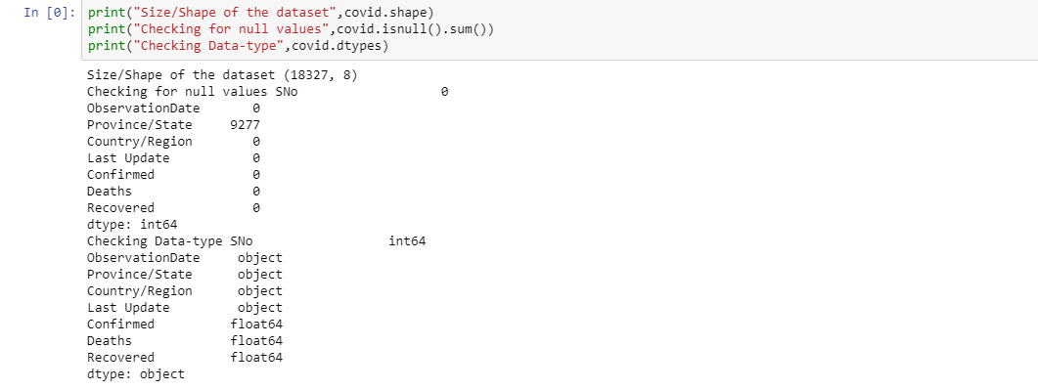
The time-arrangement united information required for all the examination to
be acted in this journal fall into these two classes:
Type: Affirmed Cases, Passings, and the Recuperated;
Geology: Worldwide, and the US as it were.

Slide 15
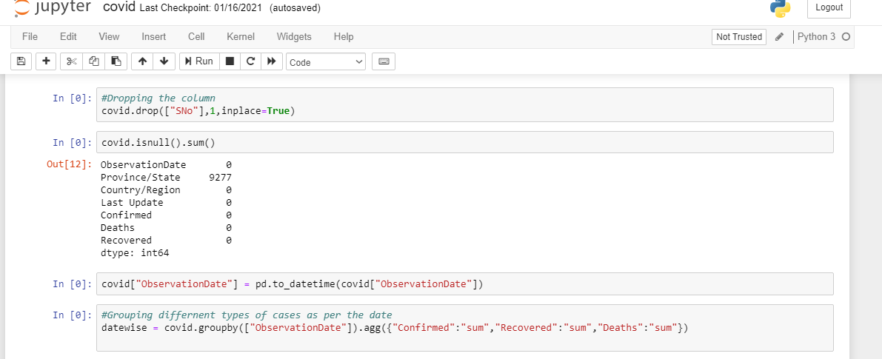
Printing the summary of the dataset and finding the null values.

Slide 16
Dropping the null values and filling with ‘True’ Boolean value. And finding the observation of different regions in the dataset

Slide 17
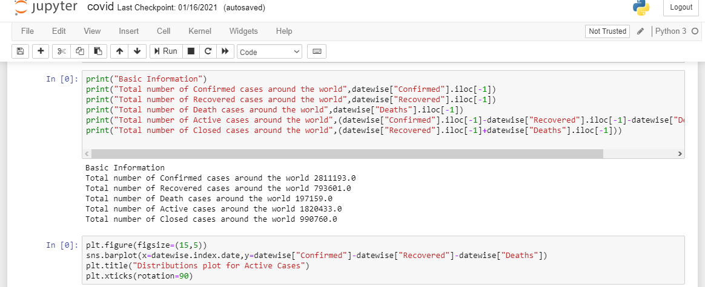
Printing the total number of confirmed cases and recovered cases in different regions.

Slide 18
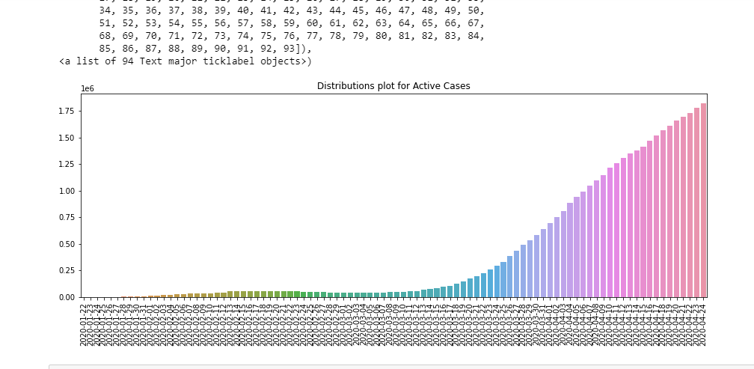
Distribution plot for Active Cases

Slide 19
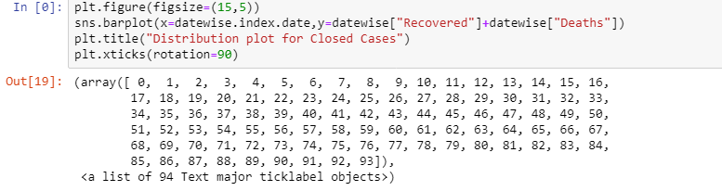
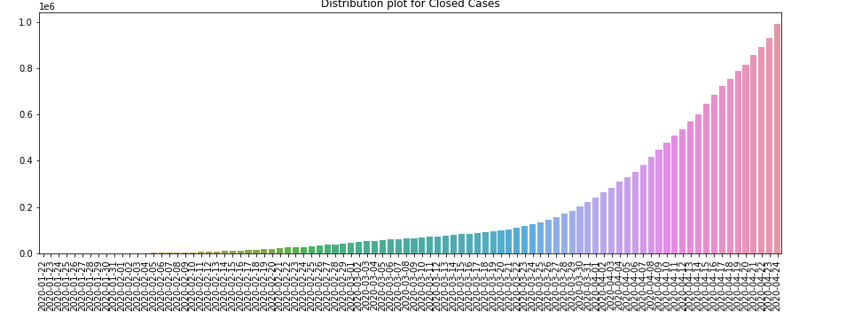
Finding the distribution plot of closed states for more number of confirmed cases

Slide 20
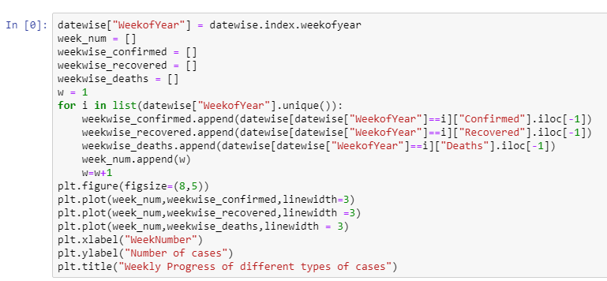
Resulting the weekly progress of different types of cases in different regions with respective to the number of cases by week number.

Slide 21
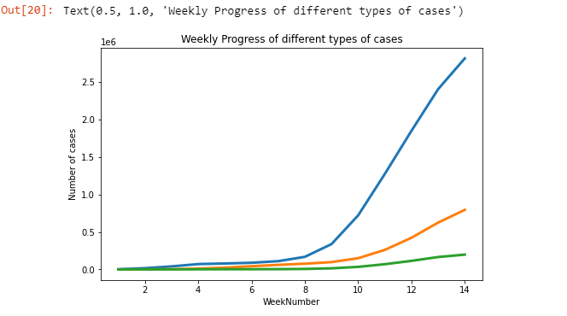

Slide 22
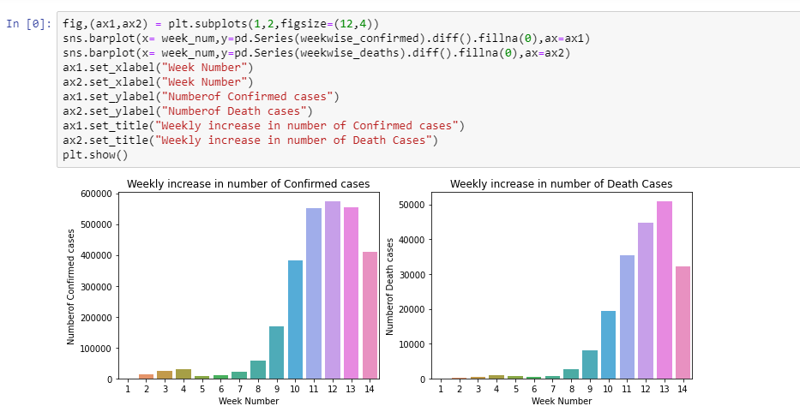
Plotting the histogram on number of confirmed cases and number of death cases weekly wise

Slide 23
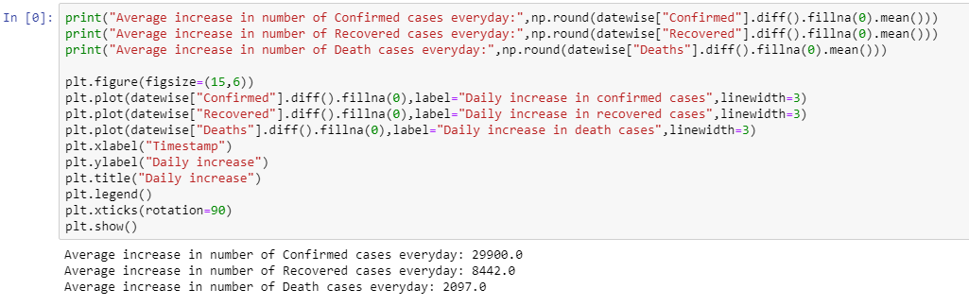
Finding the average increased number of confirmed cases and number of recovered cases along with number of death cases everyday.

Slide 24
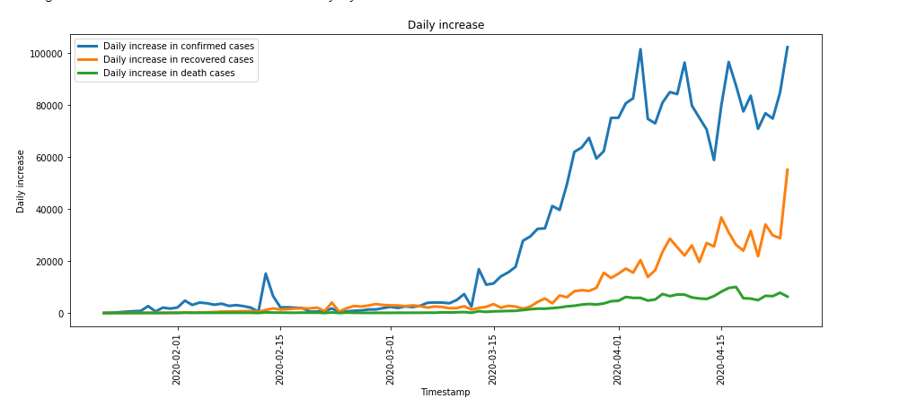
Plotting a graph on the three scenarios above with symbolic representation - blue, green , orange

Slide 25
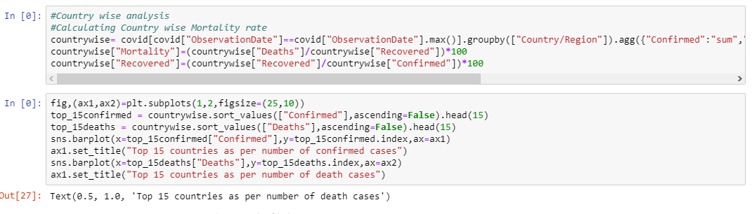
Calculating the country wise mortality rate analysis.

Slide 26
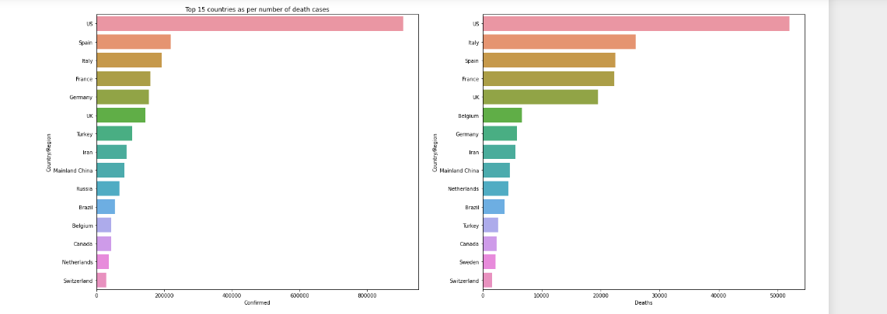
Plotting an graph on mortality rate analysis

Slide 27
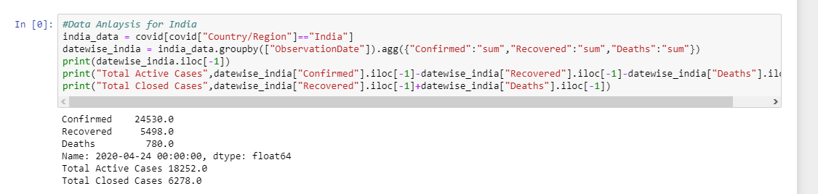
Summarizing the data analysis on india

Slide 28
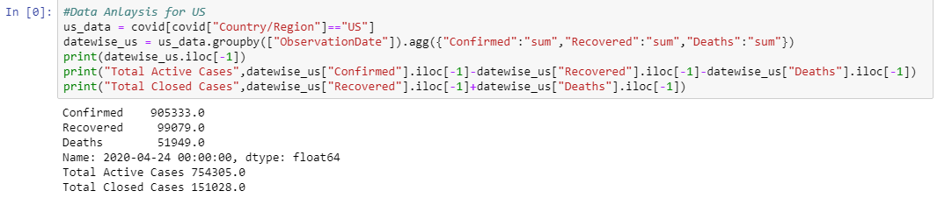
Summarizing the data analysis on US country.

Slide 29
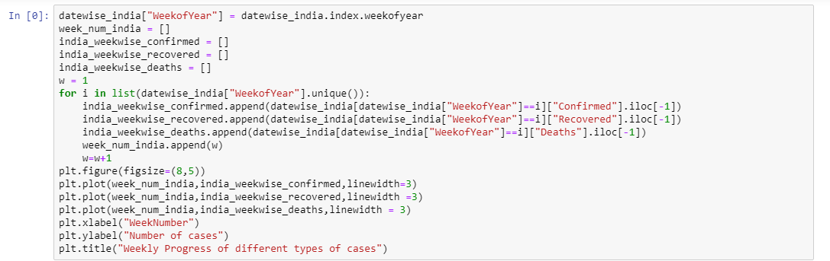
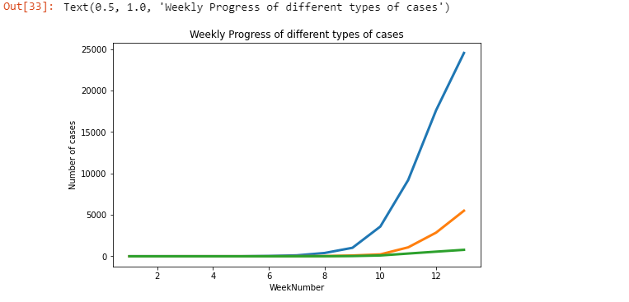
Printing the week wise confirmed , death cases of country india.

Slide 30
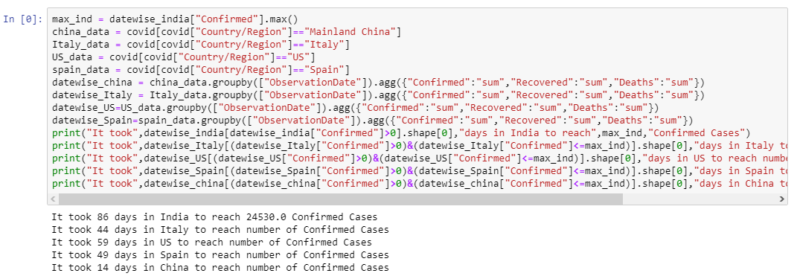
Data wise confirmed cases for specific days.

Slide 31
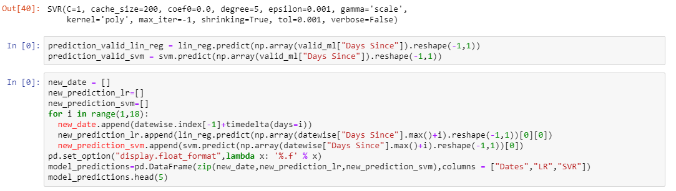
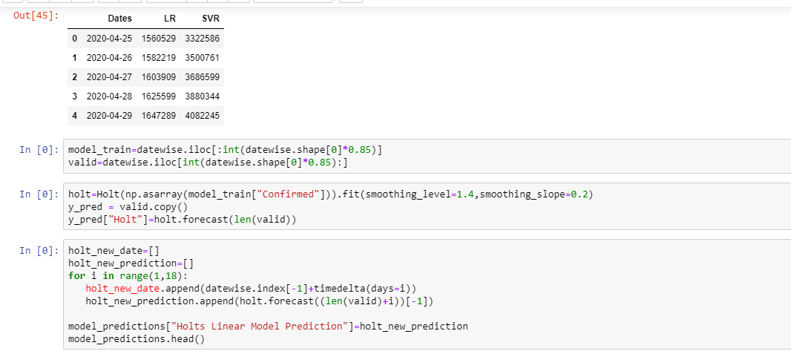
Applying the svr methodology on country india.

Slide 32
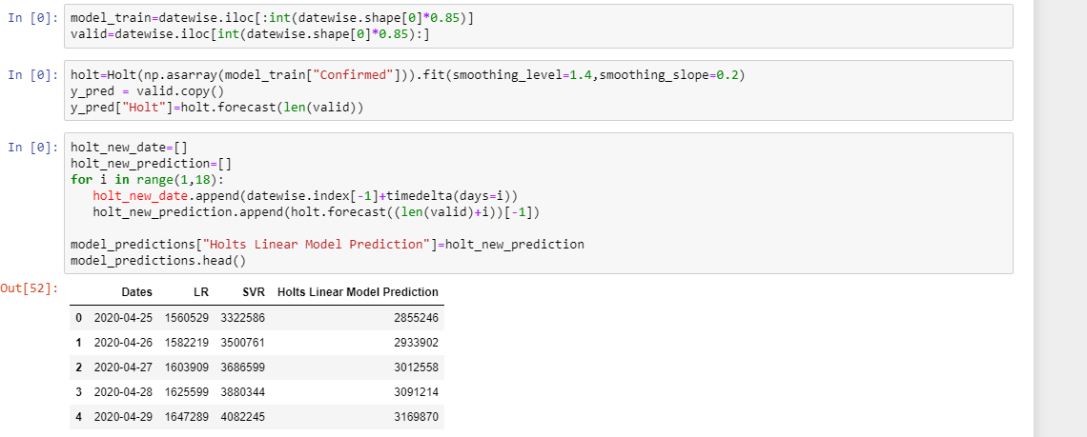
Making the predictions on the training and testing dataset of area wise.

Slide 33
CONCLUSION
The instability of the Coronavirus pandemic can light a gigantic worldwide emergency. A few specialists and government offices all through the world have anxieties that the pandemic can influence a huge extent of the total populace organizations all through the world have fears that the pandemic can influence a huge extent of the total populace.

Slide 34
FUTURE SCOPE
The new methodology might be utilized for the future ordered characterization of various microorganisms which are of specific significance during a pandemic, for example, Coronavirus.
The methodology affirms the utility of arrangement free and AI approaches utilizing relative computations to separate between indirectly related species, for example, Coronavirus - 19.

